Slide 1
Group 14 C.A.N.E
Computerized Assistive
Near Eyesight
Carlos Diego Arevalo
Becca Englehart
Clement Hall
Davis Hilton

Slide 2
~Carlos Diego Arevalo
An electrical engineering student at the university of central Florida and will be graduating in December 2020. Carlos is employed as an Electrical Designer for Wilson & Girgenti. He hopes to continue his career with Wilson & Girgenti and take the FE in the near future.

Slide 3
~Becca Englehart
A senior at the University of Central Florida and will be graduating in December 2020 with a Bachelor of Science degree in Computer Engineering.

Slide 4
~Clement Hall
A senior at University of Central Florida studying Computer Engineering and will be graduating in December 2020

Slide 5
~Davis Hilton
A senior electrical engineering student graduating from the University of Central Florida in December 2020 with a Bachelor’s of Science degree in Electrical Engineering. He was a CWEP participant for Lockheed Martin and is seeking employment in his field to become an engineer, and will be taking the FE soon after graduating.

Slide 6
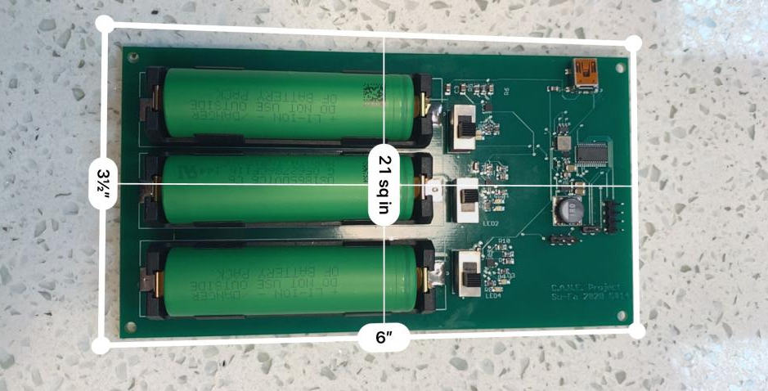
C.A.N.E PCB

Slide 7
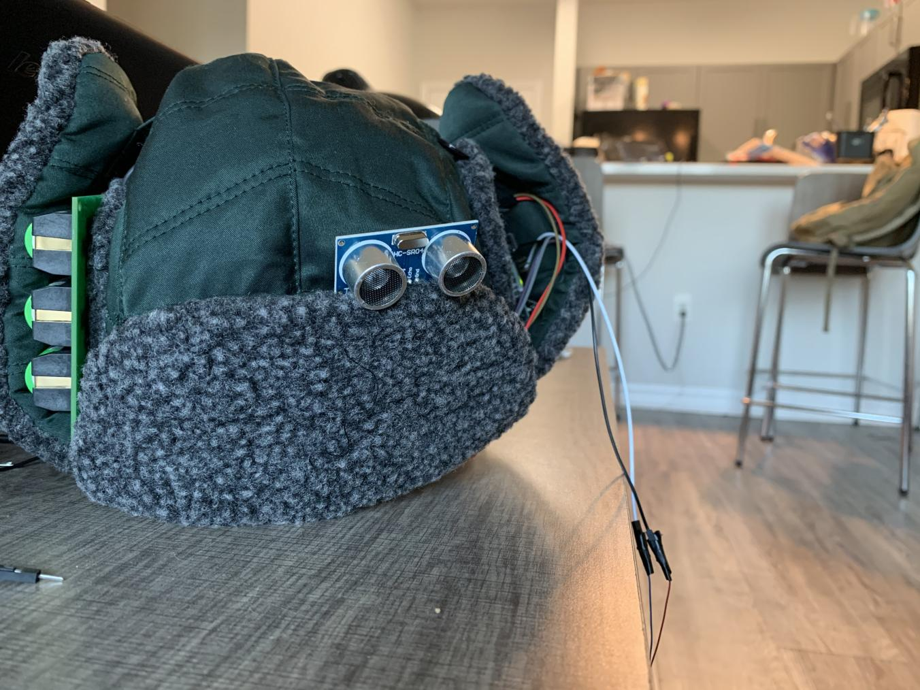
C.A.N.E

Slide 8
Final Bill of Materials
Part Description | Quantity | Price per Unit | Manufacturer | Part No.
Raspberry Pi 4 | 1 | $35.00 | Raspberry Pi
RPi Camera Module v2 | 1 | $8.77 | Raspberry Pi
Ultrasonic Sensors | 2 | $26.25 | MaxBotix Inc. | MB1010
Ultrasonic Sensors | 2 | $4.95-7.99 | SainSmart | HC-SR04

Slide 9
Optical sensors | 2 | $60.06 | Broadcom Ltd. | AFBR-S50MV85G
Glasses | 1 | $5.00 - $15.00 | Unknown
Vibrating Motors | 5-7 | $1.95 | Adafruit | 1201
Micro-Controller | 1 | $0-$1.84 | Texas Instr. | MSP430G2553
Re-charging IC | 3 | $0.476 | Skyworks | AAT3693
Li-Ion Battery | 3 | $4.99 | Panasonic | NCR18650B

Slide 10
Li-Ion Battery Holder | 3 | $2.97 | Keystone Electronics | 36-1043-ND
PCB | 1 | $212.00 *(+120 for redesign)
16ch PWM/Servo Controller for RPi | 1 | $17.50 | Adafruit | 2327
5V Voltage Reg. | 1 | $2.47 | Texas Instr. | TPS61230
3.3V Voltage Reg. | 1 | $2.60 | Texas Instr. | TPS630242YFF
Ushanka Hat | 1 | $20 | Target
Total |  | 642.67

